Slide 1
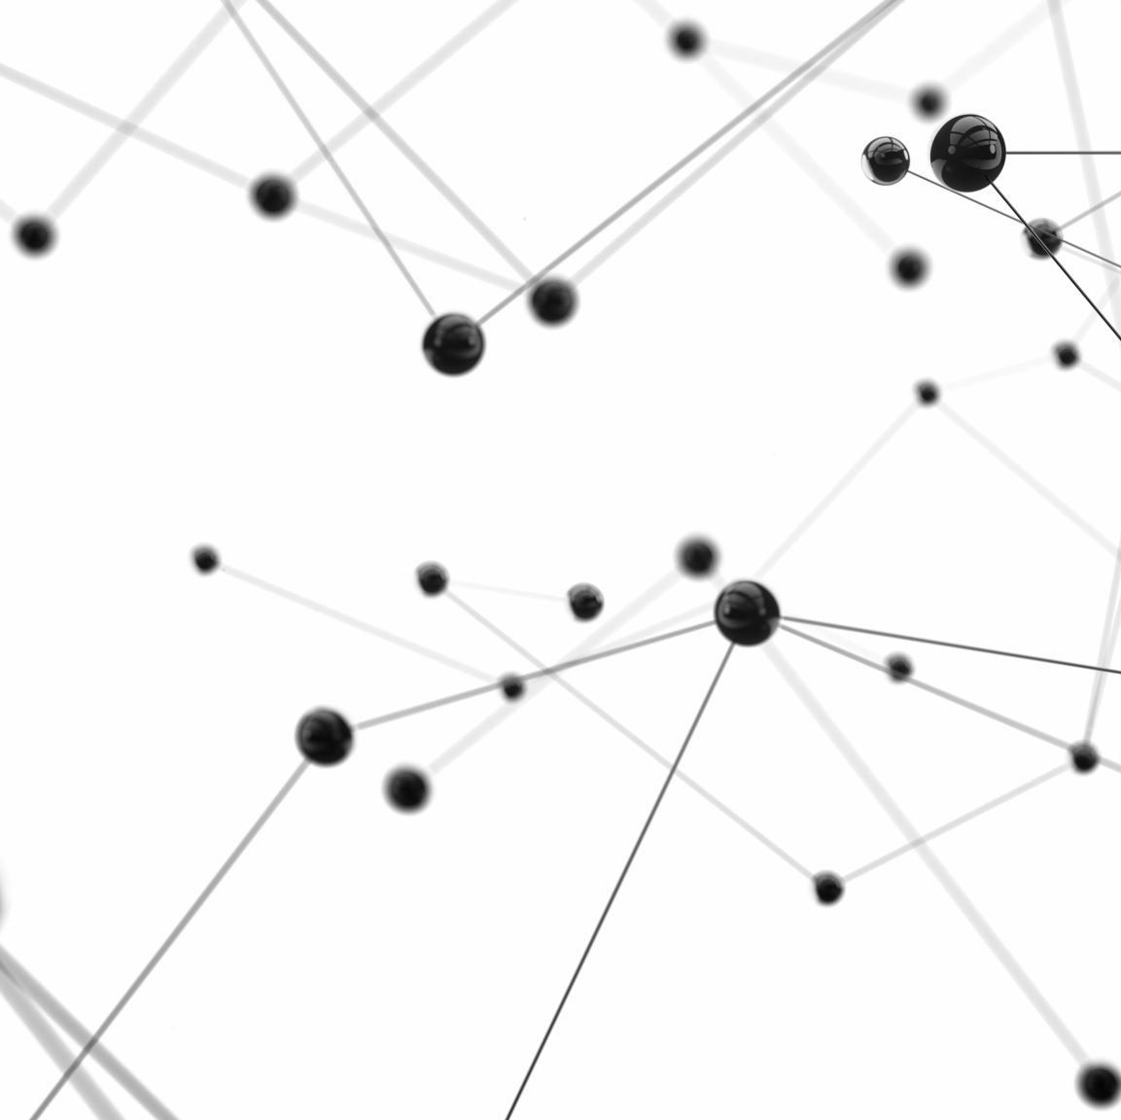
CSE 495B Natural Language Processing
Lecture 4: Feature Extraction and Embeddings

Slide 2
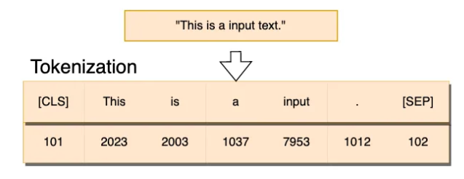
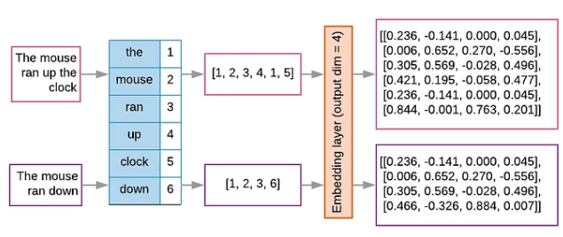
Text vs Number
Machine learning algorithms operate on a numeric feature space expecting input as a two-dimensional array where
Rows are instances and
Columns are features
To perform machine learning on text, we need to transform our documents into vector representations so that we can apply numeric machine learning

Slide 3
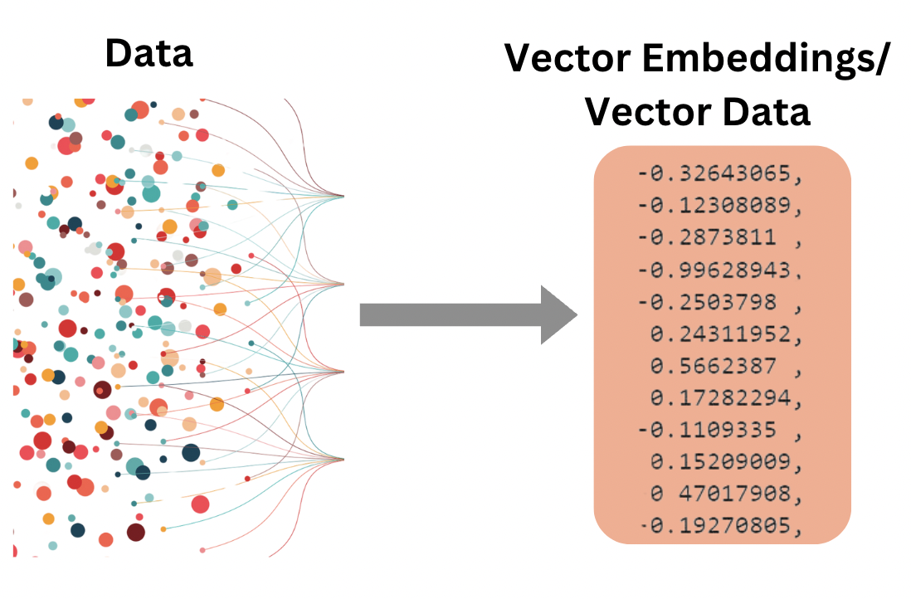
Text vs Number
This process of converting text to number is called feature extraction or simply, vectorization, and is an essential first step toward language-aware analysis
In modern NLP this is called representation learning (for words, sentences, sequence, etc.)

Slide 4
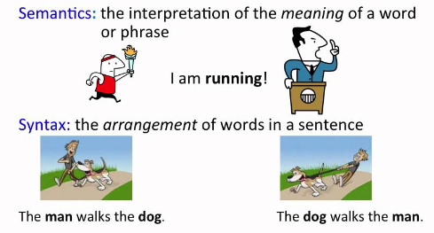
Syntax vs Semantics
Syntax defines the grammatical structures or the rules defining a language
It can be thought of as a set of principles that define how words can be put in sentences or phrases
However, syntactically correct sentences may not be meaningful
Semantics on the other hand deals with meanings
Something that make sense to human

Slide 5
Syntax vs Semantics
Semantics takes care of putting words together to make sense
That is the words must follow the syntax
And, must follow meaning of the words
How can we really teach computers the meaning of the words?
At least, we must agree that it is a difficult problem
In this lecture we will primarily focus on the syntactic aspects
We will use naïve information such as how many times a word occurred in a document or in a set of documents as potential features to represent documents

Slide 6
How can we convert text to numbers?
How can we represent words using numbers?
We can use the conventional way we represent data in ML/DL:
From a sequence of words to points that occupy a high-dimensional space
Maybe semantic space
Points in space can be close together or far apart, tightly clustered or evenly distributed
Following semantic rules
Semantic space is therefore mapped in such a way where documents with similar meanings are closer together and those that are different are farther apart
At least that is our goal and hope
By encoding similarity as space and distance (in high-dimensional space), we can begin to derive the primary components of documents and draw decision boundaries in our semantic space

Slide 7
How many ways of conversion?
What should each element in the document vector be?
In this lecture we will explore several choices, each of which extends or modifies the base bag-of-word model to describe semantic space
We will look at four types of vector encoding
Frequency, one-hot, TF–IDF, and distributed representations

Slide 8
A naïve scheme: Bag of words
The simplest representation of semantic space is the bag-of-words (BoW) model.
Its core assumption is that the meaning and similarity of texts are reflected in their vocabulary — that is, documents with similar word distributions are semantically related.
However, a little brainstorming will quickly reveal many counterexamples.
This is why the model is considered naïve.
For instance, Wikipedia articles about football, Lionel Messi, or Cristiano Ronaldo are likely to appear quite similar because they share many overlapping words.
In contrast, they will have little in common with articles about smartphones or Jamuna Future Park.
Despite its simplicity, the bag-of-words model remains a surprisingly effective starting point for developing more advanced and nuanced language models.

Slide 9
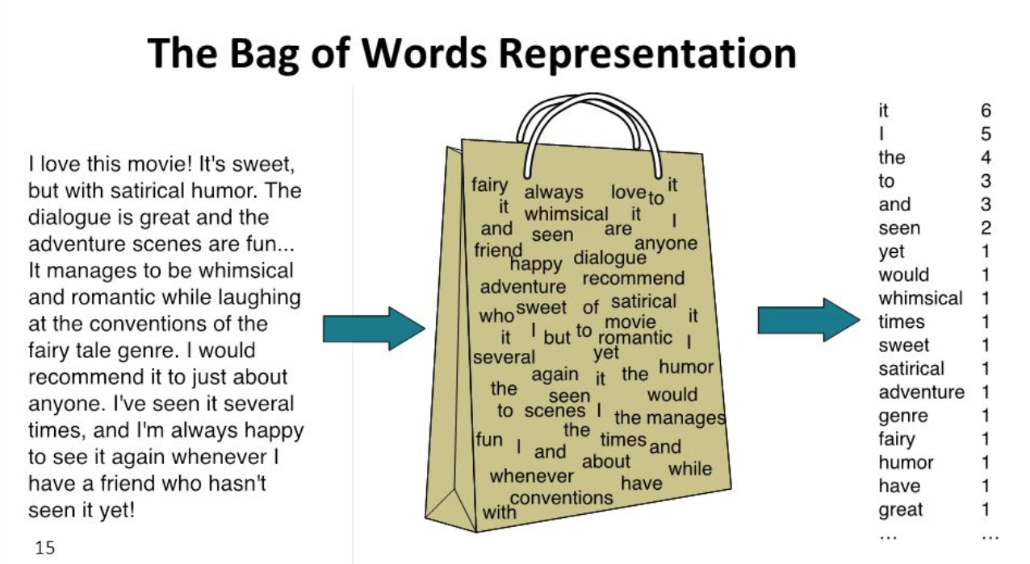
Bag of Words (BoW)

Slide 10
Bag of Words (BoW) – How to do it
To vectorize a corpus using the bag-of-words (BoW) approach, we represent each document as a vector whose length equals the size of the vocabulary in the corpus.
Each dimension of the vector corresponds to a unique token (word) in the vocabulary, and the value in that position reflects how frequently that token appears in the document.
To simplify computation, we can either:
Sort tokens alphabetically so that each word’s position in the vector is consistent, or
Maintain a dictionary (mapping) that associates each token with a specific vector index.
Either approach yields a consistent vector representation of the corpus, allowing every document to be uniquely and numerically represented for downstream processing.

Slide 11
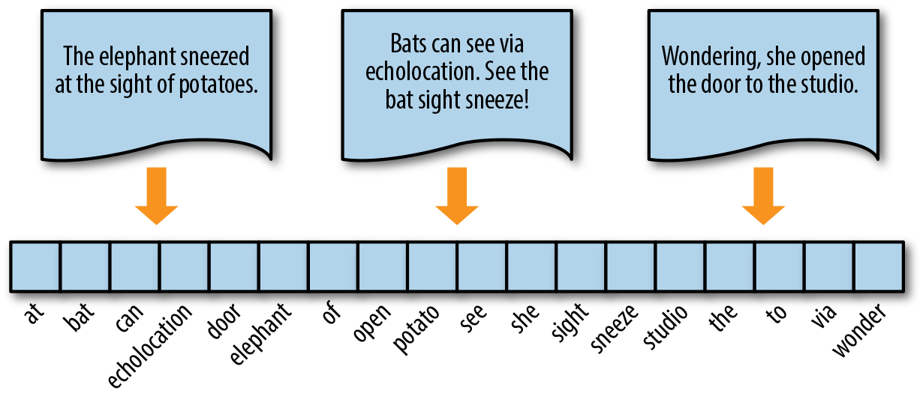
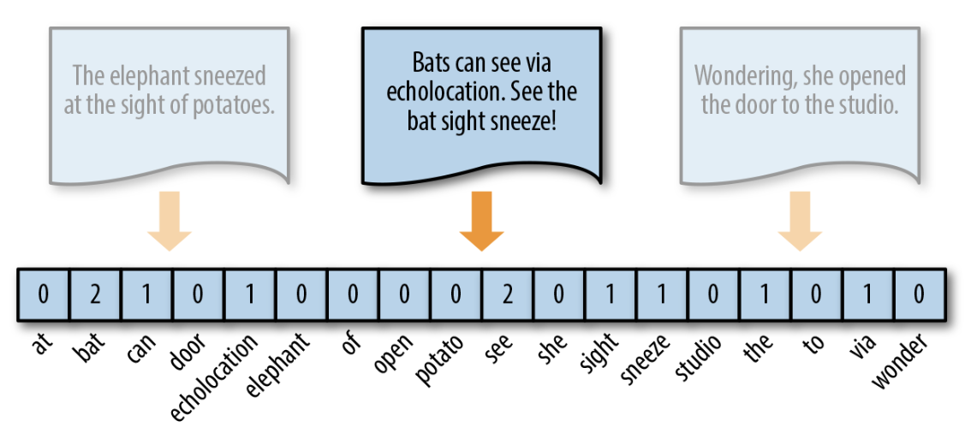
Bag of Words (BoW) – An example

Slide 12
BoW – Frequency Vectors
The simplest vector encoding model represents each document by filling a vector with word frequencies — that is, how often each word appears in the document.
In this encoding scheme,
Each document is treated as a multiset of tokens,
And the value at each word’s position in the vector corresponds to its count in the document.
This representation can take two common forms:
Raw count encoding – where each entry is simply the integer count of the word (as shown in the previous slide).
Normalized encoding – where each word frequency is weighted by the total number of words in the document, producing relative frequencies instead of raw counts.

Slide 13
Problems of frequency vectors
Frequency-based encoding methods suffer from the long-tail (Zipfian) distribution that naturally characterizes human language.
They also ignore grammar and word order, treating all tokens as independent and unordered features.
As a result, high-frequency tokens (such as common words) dominate the representation — often becoming orders of magnitude more influential than rare but semantically rich words.
This imbalance can negatively affect models, particularly those like generalized linear models, which assume features follow an approximately normal distribution.

Slide 14
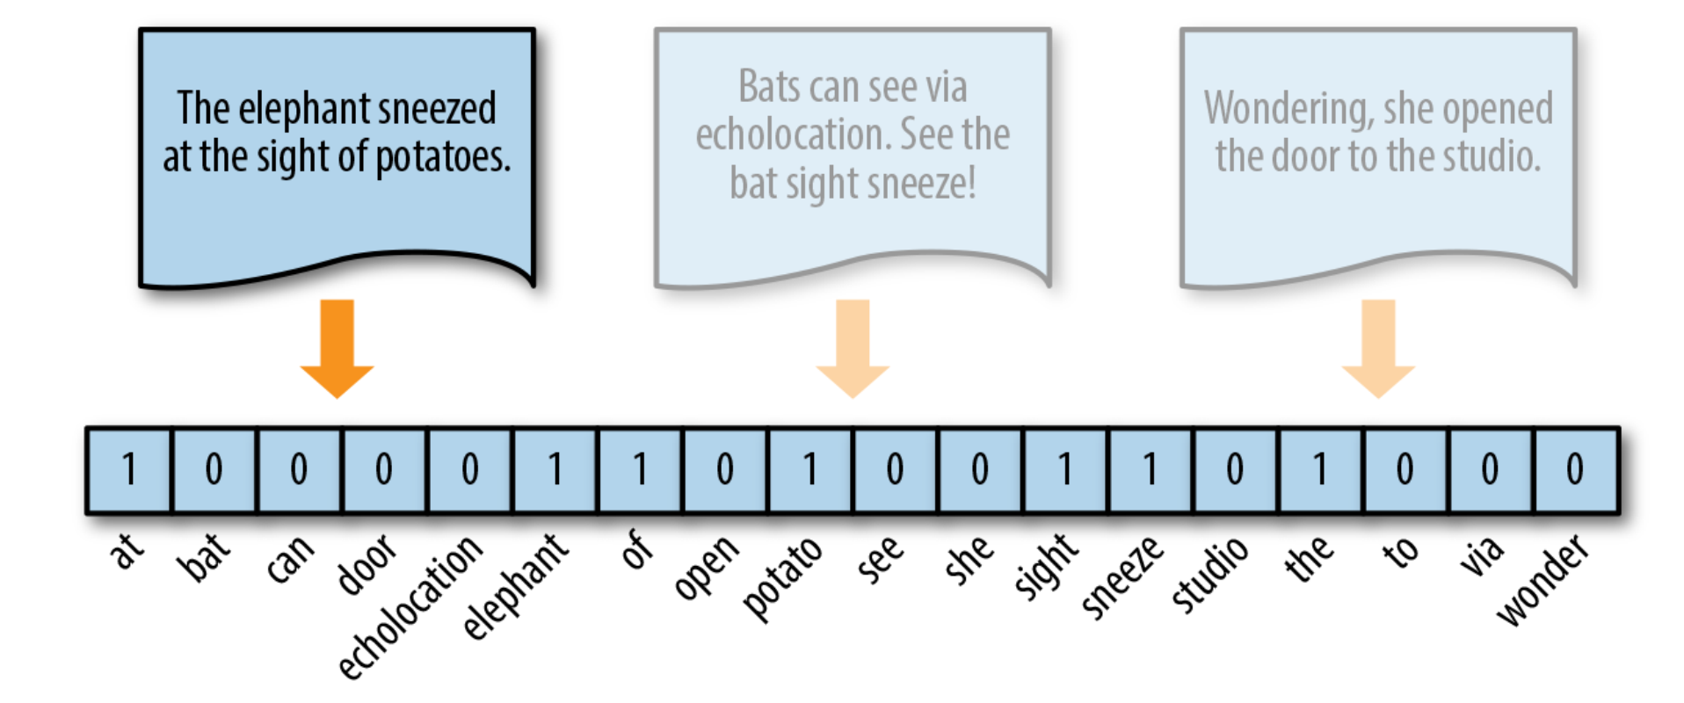
One hot encoding
A common way to address this issue is through one-hot encoding, a Boolean vector encoding method.
In this approach, each document is represented as a vector where a particular index is marked 1 (true) if the corresponding token appears in the document, and 0 (false) if it does not.
In other words, each element of the one-hot vector simply indicates the presence or absence of a given token in the text — as illustrated in the figure.

Slide 15
Why one-hot encoding?
One-hot encoding helps reduce the imbalance caused by token frequency distributions by simplifying a document into a set of its distinct components.
This representation works best for short texts—such as sentences or tweets—where repeated tokens are rare.
It is often used in conjunction with models that exhibit strong smoothing properties, ensuring that sparse feature spaces remain manageable.
One-hot encoding is also widely adopted in artificial neural networks, especially in early architectures like Recurrent Neural Networks (RNNs), to represent words.
In such cases, the 0/1 entries can be interpreted as binary probabilities indicating word presence, providing a simple yet powerful basis for word representation.

Slide 16
Bag of N-grams
All the representation schemes we have discussed so far treat words or tokens as independent units, with no awareness of phrases or word order.
The bag-of-n-grams (BoN) model attempts to address this limitation by breaking text into contiguous sequences of n words or tokens.
These sequences, known as n-grams, help capture local context, that simpler models like bag-of-words or one-hot encodings fail to represent
The corpus vocabulary (V) in this case consists of all unique n-grams found across the entire text collection.
Each document is then represented as a vector of length |V|, where each element records the frequency count of an n-gram in the document, and zero if that n-gram is absent.

Slide 17
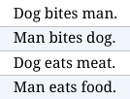
Bag of N-grams
The set of all bigrams in the corpus is:
{ dog bites, bites man, man bites, bites dog, dog eats, eats meat, man eats, eats food }.
Thus, the BoN representation consists of an eight-dimensional vector for each document, corresponding to these unique bigrams.
The bigram representations for the first two sentences are:
D₁: [1, 1, 0, 0, 0, 0, 0, 0]
D₂: [0, 0, 1, 1, 0, 0, 0, 0]

Slide 18
Problem of BoW (in general)
The bag-of-words representations we have discussed so far describe each document in isolation, without considering its relationship to the rest of the corpus.
A more informative approach is to evaluate the relative frequency or rareness of tokens in a document compared to their frequency across all documents.
The key insight is that meaningful or discriminative content is often carried by rarer terms, rather than by those that appear frequently everywhere.
For instance, in a sports corpus, words like “umpire,” “yorker,” and “swing” tend to occur more often in documents about cricket, while common terms such as “field,” “score,” and “play” appear broadly across the corpus and thus contribute less to distinguishing meaning.

Slide 19
TF-IDF
The bag-of-words methods we’ve explored so far treat all words or tokens as equally important, without recognizing that some terms carry more significance than others.
The Term Frequency–Inverse Document Frequency (TF–IDF) model addresses this limitation by quantifying how important a word is within a document relative to its frequency across the entire corpus.
In essence, TF–IDF assigns higher weights to rare but informative terms, while down-weighting common words that appear in many documents.
This approach is widely used in information retrieval systems to rank and extract relevant documents in response to a text query — and it even formed the basis of early versions of Google’s search algorithm.

Slide 20
Intuition behind TF-IDF
If a word w appears frequently in a particular document dᵢ, but rarely in the other documents dⱼ within the corpus, then w is likely to be highly informative or distinctive for dᵢ.
The importance of such a word should therefore increase with its frequency in dᵢ, yet decrease with its frequency across the rest of the corpus.
This intuition is formally captured using two measures:
Term Frequency (TF): how often a word appears in a document.
Inverse Document Frequency (IDF): how rare the word is across all documents.
By combining these two components, we obtain the TF–IDF score, which effectively balances local importance and global rarity to identify the most meaningful terms.

Slide 21

TF (Term Frequency)
Measures how often a term or word occurs in each document (horizontally).
Since different documents in the corpus may be of different lengths, a term may occur more often in a longer document as compared to a shorter document.
To normalize these counts, we divide the number of occurrences by the length of the document.
TF of a term t in a document d is defined as:

Slide 22

IDF (Inverse Document Frequency)
Measures the importance of the term across a corpus (vertically).
In computing TF, all terms are given equal importance (weightage).
However, it’s a well-known fact that stop words like is, are, am, etc., are not important, even though they occur frequently.
To account for such cases, IDF weighs down the terms that are very common across a corpus and weighs up the rare terms.
IDF of a term t is calculated as follows:

Slide 23
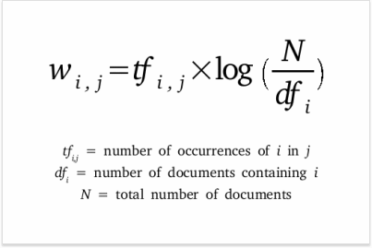
TF-IDF
TF–IDF is computed on a per-term basis, such that the relevance of a token to a document is measured by
The scaled frequency of the appearance of the term in the document
Normalized by the inverse of the scaled frequency of the term in the entire corpus

Slide 24
What we discussed until now
They are discrete representations
They treat language units (words, n-grams, etc.) as atomic units.
This discreteness hampers their ability to capture relationships between words.
The feature vectors are sparse and high-dimensional representations.
The dimensionality increases with the size of the vocabulary, with most values being zero for any vector.
This hampers learning capability. Further, high-dimensionality representation makes them computationally inefficient.
They cannot handle Out Of Vocabulary words.

Slide 25
Distributed representation
The frequency, one-hot, and TF–IDF encoding methods enable us to represent documents as vectors in a shared vector space.
However, these representations describe each document independently, without explicitly modeling relationships or similarities between documents within that space.
Moreover, since each feature (token) acts independently, there is no interaction or cooperation between terms.
As a result, it becomes difficult—or even impossible—to meaningfully compare documents that do not share any common terms, even if they are semantically related.

Slide 26
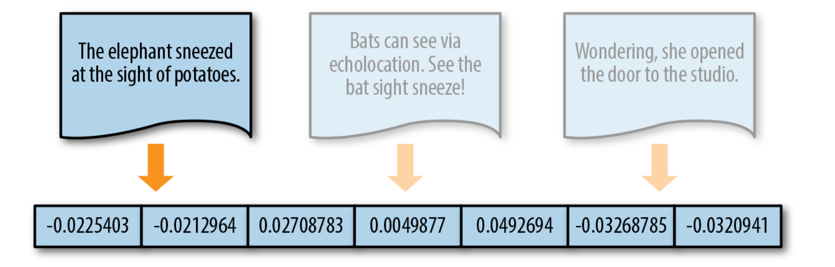
Solution: distributed representation
When document similarity is important in the context of an application, we instead encode text along a continuous scale with a distributed representation, as shown in the following Figure

Slide 27
Solution: distributed representation
This means that the resulting document vector is not a simple mapping from token position to token score
Instead, the document is represented in a feature space that has been embedded to represent word similarity
The complexity of this space (and the resulting vector length) is the product of how that representation is trained and not directly tied to the document itself

Slide 28
Word2Vec
The Word2Vec algorithm learns these embeddings using one of two architectures:
Continuous Bag-of-Words (CBOW): predicts a target word from its surrounding context.
Skip-Gram: predicts surrounding context words from a given target word.
Through this process, words that appear in similar contexts are embedded close to one another in the vector space, capturing semantic and syntactic relationships between them.
We will explore Word2Vec and its underlying mechanisms in greater detail later in this course.

Slide 29
GloVe
Word2Vec learns word embeddings by modeling the relationship between target words and their context words.
However, it does not explicitly account for how frequently certain context words appear together. Frequent co-occurrences simply result in more training examples, without adding new information.
In contrast, GloVe (Global Vectors for Word Representation) emphasizes that co-occurrence frequency itself carries meaningful statistical information that should be preserved, not treated as redundant.
GloVe constructs embeddings so that linear relationships between word vectors reflect the probabilities of their co-occurrence within the corpus, leading to a more globally informed representation of meaning.

Slide 30
FastText
The idea is very similar to Word2Vec but with a twist
Instead of using words to build word embeddings, FastText goes one level deeper
This deeper level consists of part of words and characters
In a sense, a word becomes its context
The building blocks are characters instead of words
The word embeddings built by FastText look very similar to the ones provided by Word2Vec

Slide 31
Doc2Vec
Doc2Vec is an extension of Word2Vec that introduces the concept of a paragraph vector — an unsupervised learning algorithm designed to generate fixed-length feature representations from variable-length documents.
This model captures semantic properties of words and documents, so that words like “red” and “colorful” are embedded closer together than “river” or “governance.”
Additionally, Doc2Vec considers the ordering of words within a local context, similar to an n-gram model, allowing it to encode short-range dependencies.
The resulting document vectors are more effective than traditional bag-of-words or bag-of-n-grams models because they:
Generalize better, capturing deeper semantic meaning
Have lower dimensionality while maintaining fixed-length representations
Can be directly used with standard machine learning algorithms for tasks such as classification, clustering, or similarity search

Slide 32
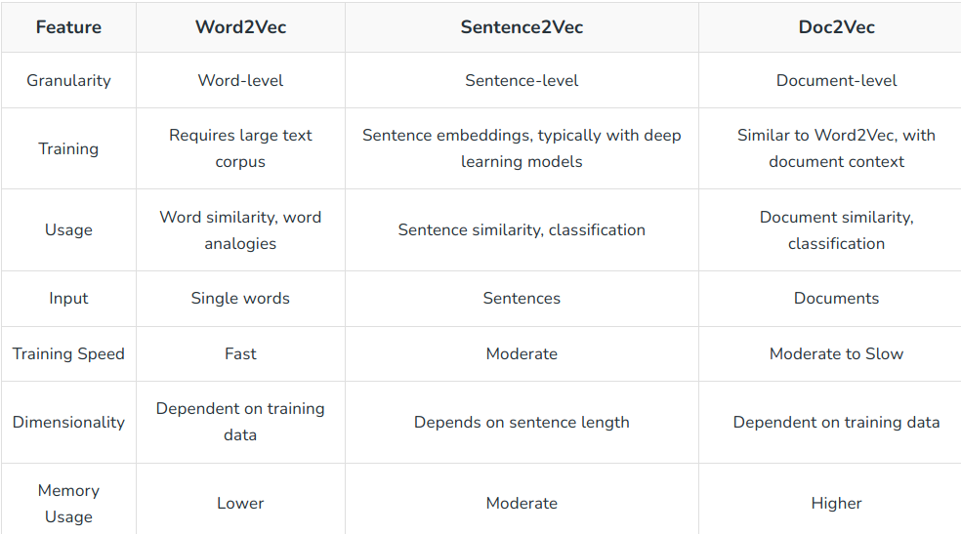
___2VEC Family

